Slide 1








Slide 2























Slide 3





Slide 4

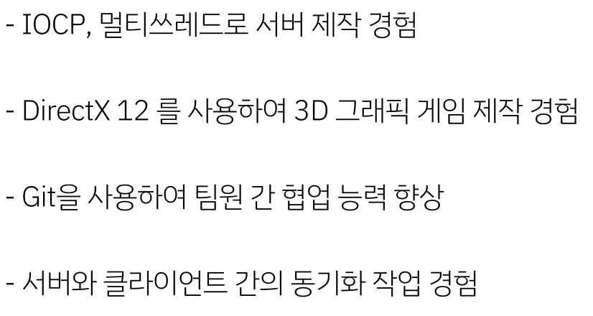

Slide 5



Slide 6
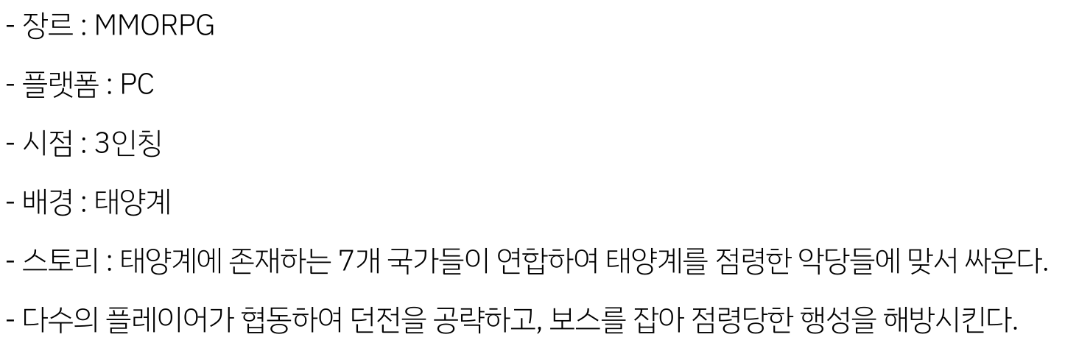
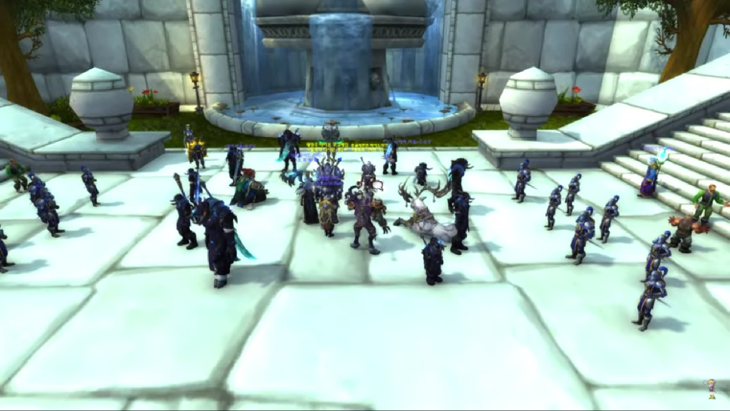
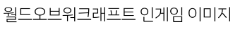

Slide 7

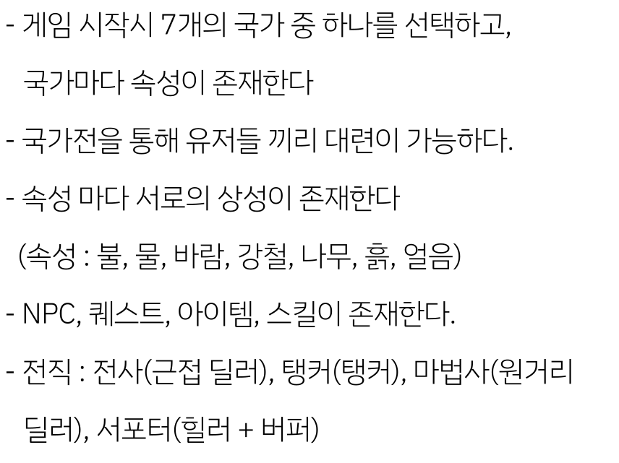
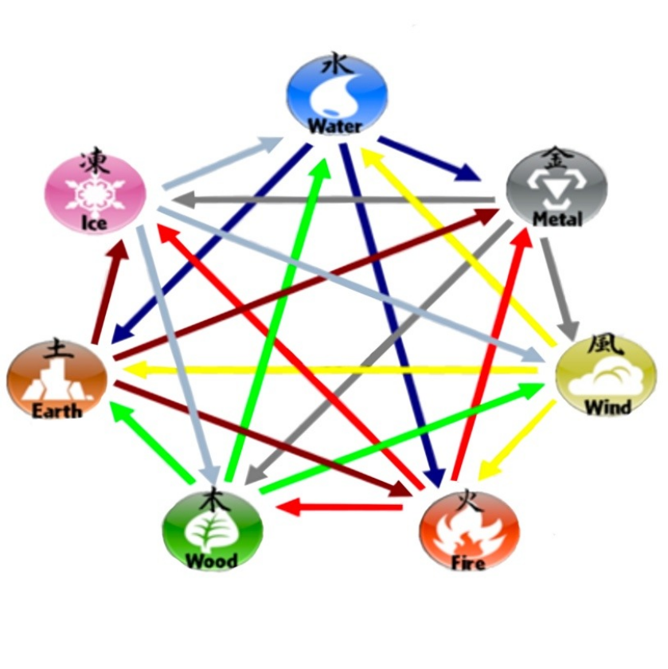

Slide 8
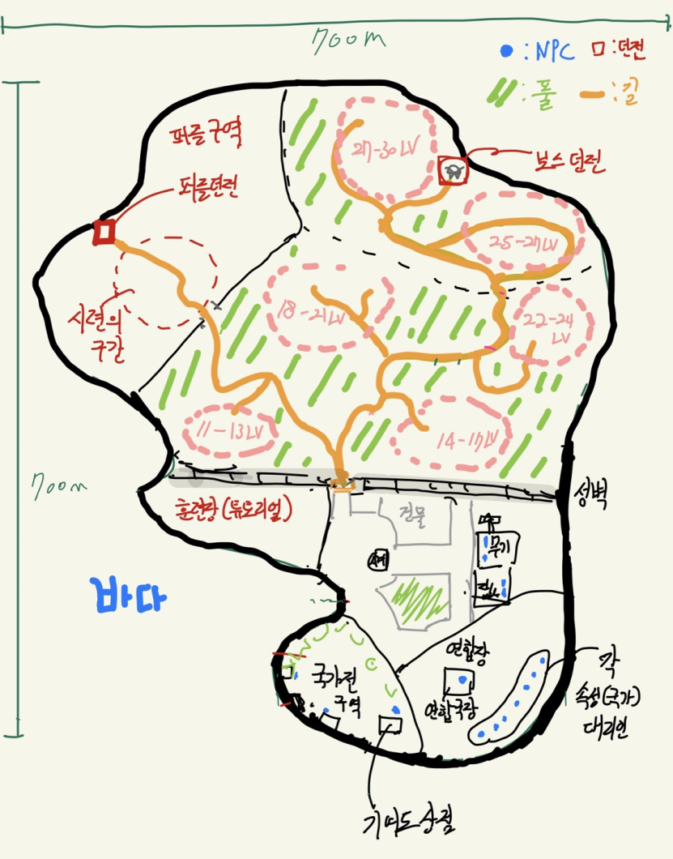

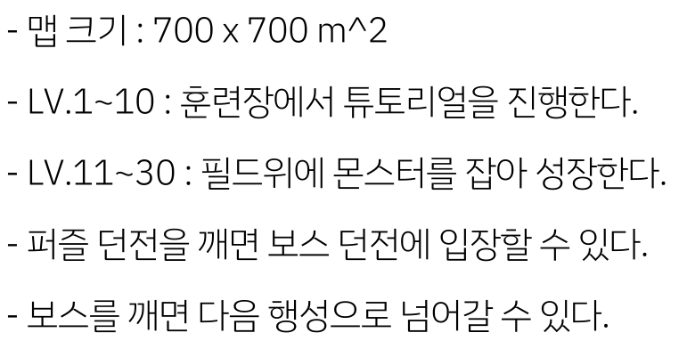

Slide 9
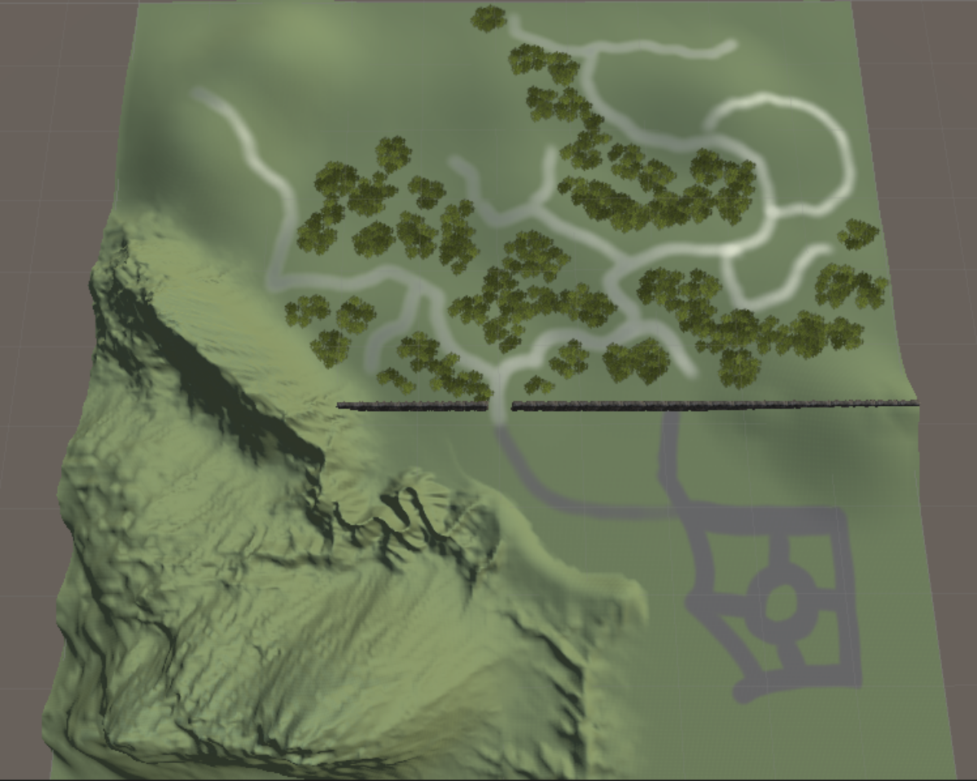

Slide 10

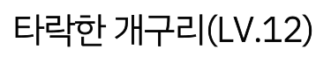
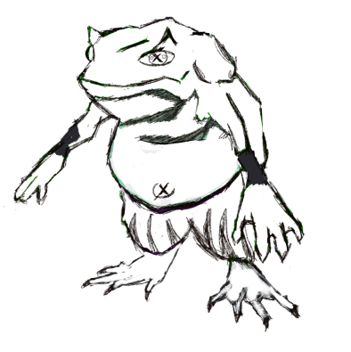
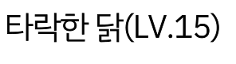
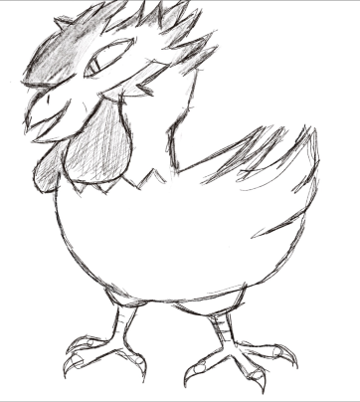
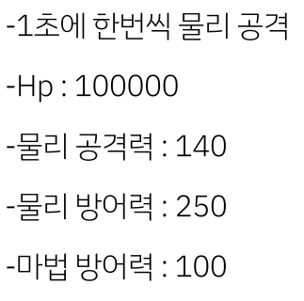
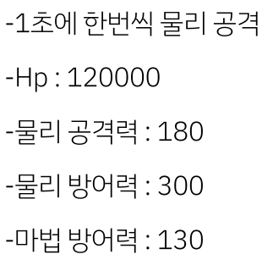
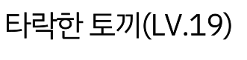

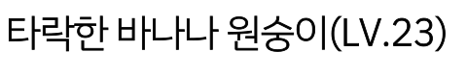
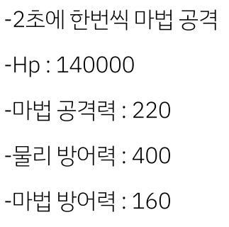
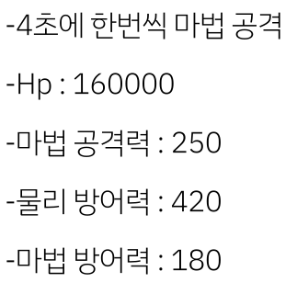


Slide 11











Slide 12



Slide 13





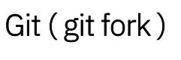



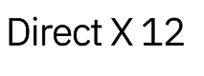






Slide 14



Slide 15

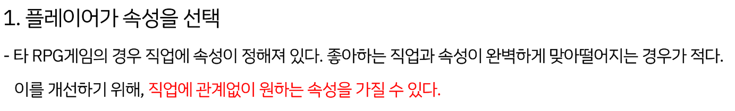
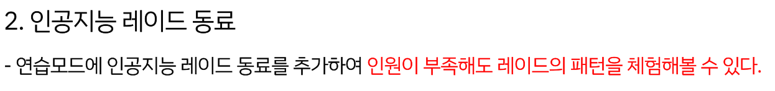

Slide 16



Slide 17

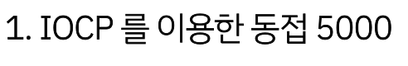

Slide 18



Slide 19
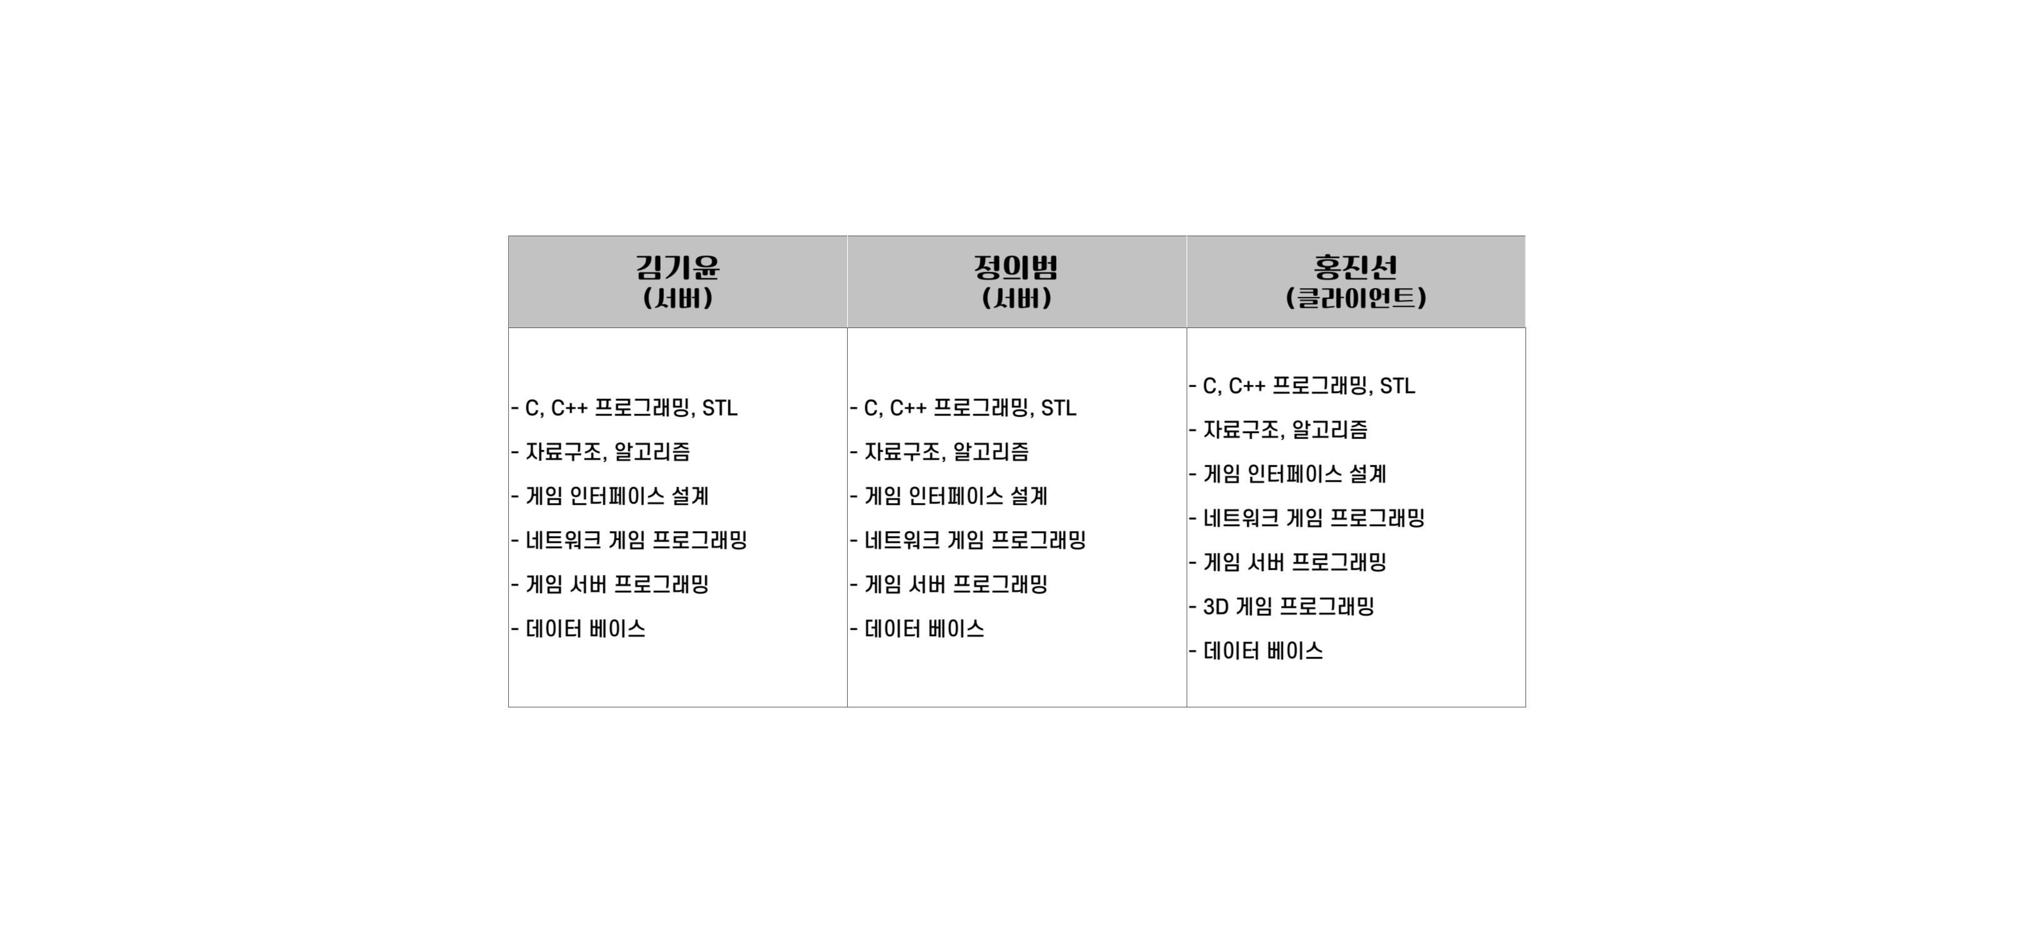


Slide 20



Slide 21

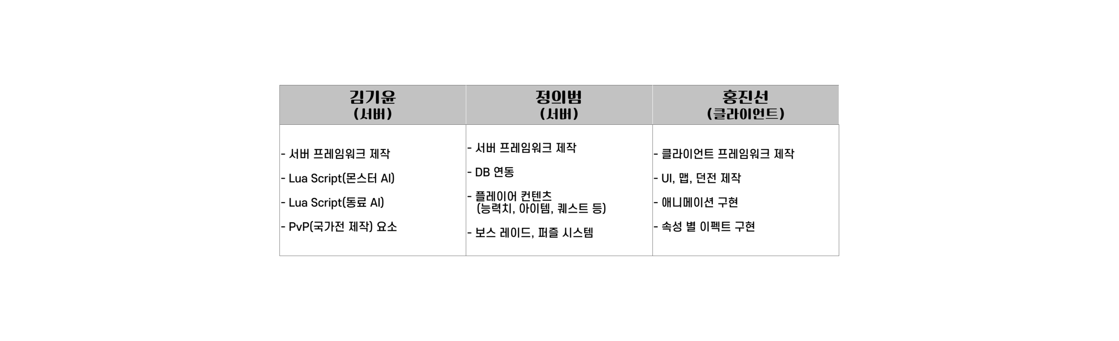

Slide 22

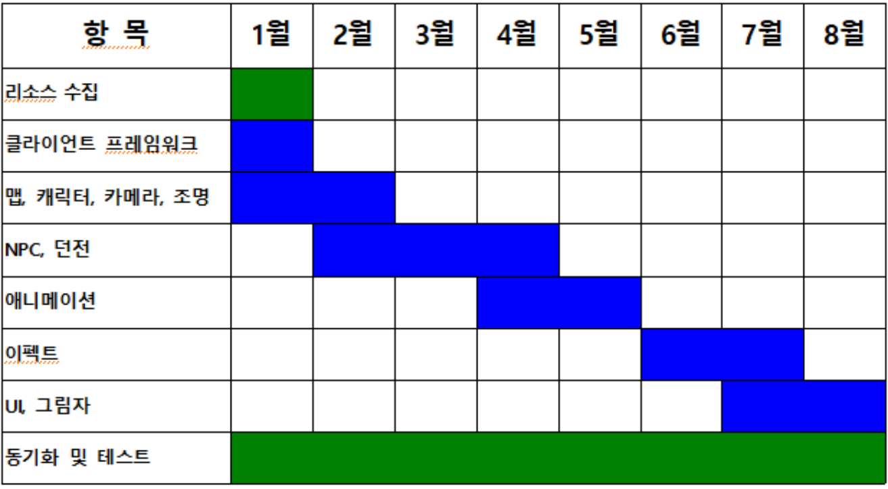


Slide 23

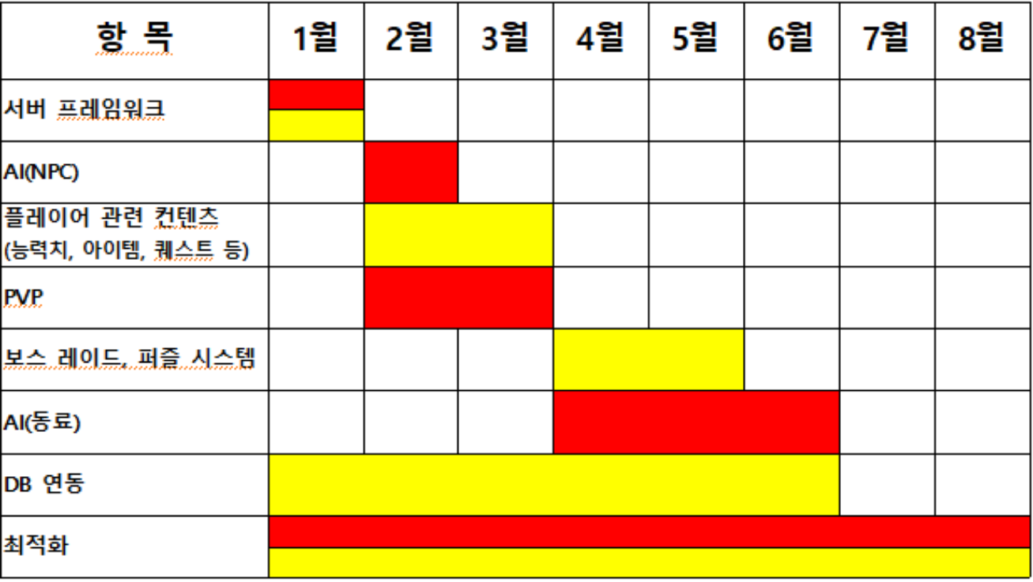
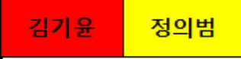

Slide 24



Slide 25

와우 스크린샷(게임소개 p.6) : https://www.youtube.com/watch?v=aMNdM2FaJdE
(특징 p.8)
속성표 : https://thepolariscollective.wordpress.com/2014/05/25/elemental-introducing-the-elementals/
(몬스터 p.10)
원숭이 : https://www.dreamstime.com/crazy-cartoon-monkey-skating-over-sized-banana-clip-art-vector-illustration-simple-gradients-all-single-layer-image166353924
(개발환경 p.11)
비쥬얼 스튜디오 : https://m.blog.naver.com/document0330/221971560457
깃 : https://ko.wikipedia.org/wiki/%EA%B9%83_(%EC%86%8C%ED%94%84%ED%8A%B8%EC%9B%A8%EC%96%B4)
깃포크 : https://git-fork.com/
Direct X : https://www.bodnara.co.kr/bbs/article.html?num=119107
MS SQL : https://m.blog.naver.com/chsmanager/220528359282
SSMS : https://www.esoftner.com/database/sql-server-management-studio-download/
Unity : https://www.google.com/url?sa=i&url=https%3A%2F%2Funity.com%2Fkr&psig=AOvVaw0v6MEQ5wcmOboawPVWVnEZ&ust=1639202842700000&source=images&cd=vfe&ved=0CAsQjRxqFwoTCIigoM3I2PQCFQAAAAAdAAAAABAD
LUA : https://ko.wikipedia.org/wiki/%EB%A3%A8%EC%95%84_(%ED%94%84%EB%A1%9C%EA%B7%B8%EB%9E%98%EB%B0%8D_%EC%96%B8%EC%96%B4)

